Slide 1
Data Preprocessing
By
E.Sivasankar
NITT

Slide 2
Data Preprocessing
Why preprocess the data?
Data cleaning
Data integration and transformation
Data reduction
Discretization and concept hierarchy generation
Summary

Slide 3
Why Data Preprocessing?
Data in the real world is dirty
incomplete: lacking attribute values, lacking certain attributes of interest, or containing only aggregate data
noisy: containing errors or outliers
inconsistent: containing discrepancies in codes or names
No quality data, no quality mining results!
Quality decisions must be based on quality data
Data warehouse needs consistent integration of quality data

Slide 4
Multi-Dimensional Measure of Data Quality
A well-accepted multidimensional view:
Accuracy
Completeness
Consistency
Timeliness
Believability
Value added
Interpretability
Accessibility
Broad categories:
intrinsic, contextual, representational, and accessibility.

Slide 5
Major Tasks in Data Preprocessing
Data cleaning
Fill in missing values, smooth noisy data, identify or remove outliers, and resolve inconsistencies
Data integration
Integration of multiple databases, data cubes, or files
Data transformation
Normalization and aggregation
Data reduction
Obtains reduced representation in volume but produces the same or similar analytical results
Data discretization
Part of data reduction but with particular importance, especially for numerical data

Slide 6
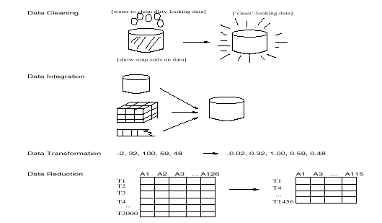
Forms of data preprocessing

Slide 7
Data Preprocessing
Why preprocess the data?
Data cleaning
Data integration and transformation
Data reduction
Discretization and concept hierarchy generation
Summary

Slide 8
Data Cleaning
Data cleaning tasks
Fill in missing values
Identify outliers and smooth out noisy data
Correct inconsistent data

Slide 9
Missing Data
Data is not always available
E.g., many tuples have no recorded value for several attributes, such as customer income in sales data
Missing data may be due to
equipment malfunction
inconsistent with other recorded data and thus deleted
data not entered due to misunderstanding
certain data may not be considered important at the time of entry
not register history or changes of the data
Missing data may need to be inferred.

Slide 10
How to Handle Missing Data?
Ignore the tuple: usually done when class label is missing (assuming the tasks in classification—not effective when the percentage of missing values per attribute varies considerably.
Fill in the missing value manually: tedious + infeasible?
Use a global constant to fill in the missing value: e.g., “unknown”, a new class?!
Use the attribute mean to fill in the missing value
Use the attribute mean for all samples belonging to the same class to fill in the missing value: smarter
Use the most probable value to fill in the missing value: inference-based such as Bayesian formula or decision tree

Slide 11
Noisy Data
Noise: random error or variance in a measured variable
Incorrect attribute values may due to
faulty data collection instruments
data entry problems
data transmission problems
technology limitation
inconsistency in naming convention
Other data problems which requires data cleaning
duplicate records
incomplete data
inconsistent data

Slide 12
How to Handle Noisy Data?
Binning method:
first sort data and partition into (equi-depth) bins
then one can smooth by bin means, smooth by bin median, smooth by bin boundaries, etc.
Clustering
detect and remove outliers
Combined computer and human inspection
detect suspicious values and check by human
Regression
smooth by fitting the data into regression functions

Slide 13
Noise Removal methods
Noise-Noise is a random error or variance in a measured variable.
Binning
Binning methods smooth a sorted data value by consulting its neighborhood. The sorted values are distributed into a no. of buckets or bins.
In smoothing by bin means each value of the bin is replaced by the mean value of the bin.
In smoothing by bin boundaries, the minimum and maximum values in a given bin are identified as the bin boundaries. Each bin value is then replaced by the closest boundary value.

Slide 14
Binning Methods for Data Smoothing
* Sorted data for price (in dollars): 4, 8, 9, 15, 21, 21, 24, 25, 26, 28, 29, 34
* Partition into (equi-depth) bins:
- Bin 1: 4, 8, 9, 15
- Bin 2: 21, 21, 24, 25
- Bin 3: 26, 28, 29, 34
* Smoothing by bin means:
- Bin 1: 9, 9, 9, 9
- Bin 2: 23, 23, 23, 23
- Bin 3: 29, 29, 29, 29
* Smoothing by bin boundaries:
- Bin 1: 4, 4, 4, 15
- Bin 2: 21, 21, 25, 25
- Bin 3: 26, 26, 26, 34

Slide 15
Clustering
Outliers (abnormal patterns) may be detected by clustering where similar values are organized into groups or clusters. The values that fall out side of the clusters may be considered as outliers.

Slide 16
Cluster Analysis

Slide 17
Regression
We can smooth data by fitting the data to a function. Linear regression involves finding the best line to fit two variables so that one variable can be used to predict the other.
Multiple linear regression is an extension of linear regression where more than two variables are involved and data are fitted into a multi-dimensional surface.

Slide 18
Regression
y
Y1
Y1’
y = x + 1
X1
x

Slide 19
Data Preprocessing
Why preprocess the data?
Data cleaning
Data integration and transformation
Data reduction
Discretization and concept hierarchy generation
Summary

Slide 20
Data Integration
Data integration:
combines data from multiple sources into a coherent store
Schema integration
integrate metadata from different sources
Entity identification problem: identify real world entities from multiple data sources, e.g., A.cust-id ≡ B.cust-#
Detecting and resolving data value conflicts
for the same real world entity, attribute values from different sources are different
possible reasons: different representations, different scales, e.g., metric vs. British units

Slide 21
Handling Redundant Data in Data Integration
Redundant data occur often when integration of multiple databases
The same attribute may have different names in different databases
One attribute may be a “derived” attribute in another table, e.g., annual revenue
Redundant data may be able to be detected by correlation analysis
Careful integration of the data from multiple sources may help reduce/avoid redundancies and inconsistencies and improve mining speed and quality

Slide 22
Redundancy
An attribute may be redundant if it can be derived from another table. Redundancy can be deducted by correlation analysis.

Slide 23
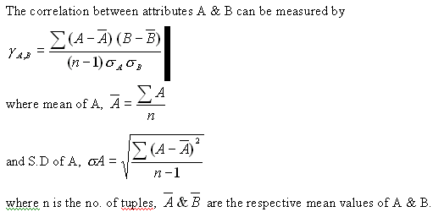
Correlation Analysis

Slide 24
Correlation Analysis
If the resulting value of the equation is greater than 0, then A & B are positively correlated, meaning that the value of A increases as the value of B increases.
If the resulting value < 0, then A & B are negatively correlated, where the value of one attribute increases as the value of the other attribute decreases.

Slide 25
Data Transformation
Smoothing: remove noise from data
Aggregation: summarization, data cube construction
Generalization: concept hierarchy climbing
Normalization: scaled to fall within a small, specified range
min-max normalization
z-score normalization
normalization by decimal scaling
Attribute/feature construction
New attributes constructed from the given ones

Slide 26
Data Transformation: Normalization
min-max normalization
z-score normalization
normalization by decimal scaling
Where j is the smallest integer such that Max(| |)<1

Slide 27
Min-Max Normalistaion
It performs linear transformation on the original data. Suppose min_{A} and max_{A} are the minimum and maximum values of an attribute A min-max normalization maps a value V of A to V¹ in the range [new-Min_{A}, new-max_{A}]
Ex. Suppose the minimum and maximum values for the attribute income are $12,000 and $98,000 respectively. We would like to map the income to the range [0.0 to 1.0]. By min-max normalization a value of $73,600 for income is transformed into

Slide 28
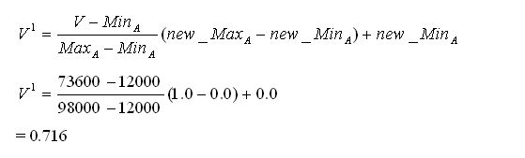

Slide 29
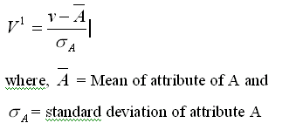
Z-score normalization (or) Zero-Mean Normalization
In Z-score normalization, the values for an attribute A are normalized based on the mean and S.D. of A. A value V of A is normalized to V¹ by computing

Slide 30
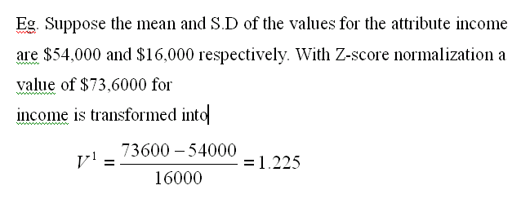

Slide 31
Normalization by decimal scaling
It normalizes by moving the decimal point over the values of attribute A. The no. of decimal points moved depends on the maximum absolute value of A. A value V¹ of A is normalized by computing

Slide 32
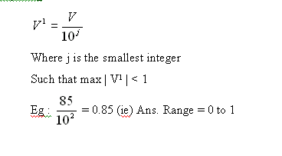

Slide 33
Data Preprocessing
Why preprocess the data?
Data cleaning
Data integration and transformation
Data reduction
Discretization and concept hierarchy generation
Summary

Slide 34
DATA REDUCTION
Data reduction techniques can be applied to obtain a reduced representation of the data set that is much smaller in volume yet produces the same analytical results.
1.Data cube reduction Here aggregation operations are applied to the data in the construction of a data cube.
2.Dimension reduction Here irrelevant, weak and redundant attributes or dimensions may be deleted and removed

Slide 35
DATA REDUCTION
3.Data compression
Here encoding mechanisms are used to reduce the data set size.
4.Discretization and concept hierarchy generation
Here raw data values for attributes are replaced by ranges or higher conceptual level.

Slide 36
Data Cube aggregation
Data cubes store multi-dimensional aggregate information.
It provides fast access to pre computed, summarized data, thereby benefiting online analytical processing (OLAP) as well as data mining.
Each cell in a data cube holds an aggregate data value, corresponding to a data point on a multi-dimensional space.
The cube created at the lowest level of abstraction is referred to as the base cuboid. A cube for the highest level of abstraction is the apex cuboid. Data cubes created by varying levels of abstraction is often referred to as lattice of cuboid.

Slide 37
Dimensionality reduction
It reduces the data set size by removing attributes or dimensions from a cube.
We need to find a minimum set of attributes such that the resulting probability distribution of classes is as close as possible to the original distribution obtained using all attributes.

Slide 38
1.Stepwise forward selection
The procedure starts with an empty set of attributes.
The best of the original attributes is determined and is added to the set.
At each subsequent iteration, the best of the remaining attributes are added to the set.

Slide 39
2.Stepwise backward elimination
This procedure starts with the full set of attributes. At each step is removes the worst attribute remaining in the set.
3.Combination of forward selection and backward elimination
Here, at each step, the procedure selects the best attribute and removes the worst among the remaining attributes.

Slide 40
Data Compression
Data encoding or transformations are applied so as to obtain a reduced or compressed representation of the original data.
If the original data can be reconstructed from the compressed data without any loss of information, the data compression technique is called “lossless”.
If we can reconstruct only an approximation of the original data, then the data compression technique is called as “lossy compression”

Slide 41
Data Compression
String compression
There are extensive theories and well-tuned algorithms
Typically lossless
But only limited manipulation is possible without expansion
Audio/video compression
Typically lossy compression, with progressive refinement
Sometimes small fragments of signal can be reconstructed without reconstructing the whole

Slide 42
Data Compression
Original Data
Compressed
Data
lossless
Original Data
Approximated
lossy

Slide 43
Wavelet Transforms
Haar2
Daubechie4
Discrete wavelet transform (DWT): linear signal processing
Compressed approximation: store only a small fraction of the strongest of the wavelet coefficients
Similar to discrete Fourier transform (DFT), but better lossy compression, localized in space
Method:
Length, L, must be an integer power of 2 (padding with 0s, when necessary)
Each transform has 2 functions: smoothing, difference
Applies to pairs of data, resulting in two set of data of length L/2
Applies two functions recursively, until reaches the desired length

Slide 44
Wavelet transformation
The discrete wavelet transform (DWT) is a linear signal processing technique that when applied to a data vector D, transforms it to a numerically different vector D’ of wavelet coefficients. The two vectors are of the same length.
For example, all wavelet coefficients larger than the user specified threshold can be retained. The remaining co-efficient is said to be zero.

Slide 45
1. The length L of the input data vector must be an integer power of 2. This condition can be met by padding the data vectors with zeros, as necessary.
2.Each transform involves applying two functions. The first applies a data smoothing function such as sum or weighted average.
The second performs a weighted difference which brings out the detailed features of the data.
3.The two functions are applied to the pairs of input data, resulting in two sets of data with length L/2. In general, these represent a smoothened or low frequency version of the input data, and the high frequency content of it respectively

Slide 46
4.The two functions are recursively applied to the set of data obtained in the previous loop, until the resulting data sets obtained are of length two.
5.A selection of values from the data sets obtained in the above iteration are designated as the wavelength coefficient of the transformed data

Slide 47
Principal Component Analysis
Given N data vectors from k-dimensions, find c <= k orthogonal vectors that can be best used to represent data
The original data set is reduced to one consisting of N data vectors on c principal components (reduced dimensions)
Each data vector is a linear combination of the c principal component vectors
Works for numeric data only
Used when the number of dimensions is large

Slide 48
The basic procedure is as follows :
1.The input data is normalized so that each attribute falls within the same range. This step ensures that attributes with larger domains will not dominate attributes with smaller domains.
2.PCA computes ‘C’ ortho-normal vectors that provides a
basics for the normalized input data. These are unit vectors that each point in a direction perpendicular to others.
These vectors are referred to as principal components. The input data is a linear combination of the principal components.

Slide 49
3. The principal components are sorted in the order of decreasing significance. The principal components
essentially serve as a new set of access for data providing more information about the variance.
4.Since the components are sorted by decreasing order of
significance, the size of the data can be reduced by
eliminating the weaker components with low variance.

Slide 50
Principal Component Analysis
X2
Y1
Y2
X1

Slide 51
Numerosity Reduction
Parametric methods
Assume the data fits some model, estimate model parameters, store only the parameters, and discard the data (except possible outliers)
Log-linear models: obtain value at a point in m-D space as the product on appropriate marginal subspaces
Non-parametric methods
Do not assume models
Major families: histograms, clustering, sampling

Slide 52
Regression and Log-Linear Models
Linear regression: Data are modeled to fit a straight line
Often uses the least-square method to fit the line
Multiple regression: allows a response variable Y to be modeled as a linear function of multidimensional feature vector
Log-linear model: approximates discrete multidimensional probability distributions

Slide 53
Regress Analysis and Log-Linear Models
Linear regression: Y = α + β X
Two parameters , α and β specify the line and are to be estimated by using the data at hand.
using the least squares criterion to the known values of Y1, Y2, …, X1, X2, ….
Multiple regression: Y = b0 + b1 X1 + b2 X2.
Many nonlinear functions can be transformed into the above.
Log-linear models:
The multi-way table of joint probabilities is approximated by a product of lower-order tables.
Probability: p(a, b, c, d) = αab βacχad δbcd

Slide 54
Histograms
A popular data reduction technique
Divide data into buckets and store average (sum) for each bucket
Can be constructed optimally in one dimension using dynamic programming
Related to quantization problems.

Slide 55
Clustering
Partition data set into clusters, and one can store cluster representation only
Can be very effective if data is clustered but not if data is “smeared”
Can have hierarchical clustering and be stored in multi-dimensional index tree structures
There are many choices of clustering definitions and clustering algorithms

Slide 56
Sampling
Allow a mining algorithm to run in complexity that is potentially sub-linear to the size of the data
Choose a representative subset of the data
Simple random sampling may have very poor performance in the presence of skew
Develop adaptive sampling methods
Stratified sampling:
Approximate the percentage of each class (or subpopulation of interest) in the overall database
Used in conjunction with skewed data
Sampling may not reduce database I/Os (page at a time).

Slide 57
Sampling
SRSWOR
(simple random
sample without
replacement)
SRSWR
Raw Data

Slide 58
Sampling
Raw Data
Cluster/Stratified Sample

Slide 59
Data Preprocessing
Why preprocess the data?
Data cleaning
Data integration and transformation
Data reduction
Discretization and concept hierarchy generation
Summary

Slide 60
Discretization
Three types of attributes:
Nominal — values from an unordered set
Ordinal — values from an ordered set
Continuous — real numbers
Discretization:
divide the range of a continuous attribute into intervals
Some classification algorithms only accept categorical attributes.
Reduce data size by discretization
Prepare for further analysis

Slide 61
Discretization and Concept hierachy
Discretization
reduce the number of values for a given continuous attribute by dividing the range of the attribute into intervals. Interval labels can then be used to replace actual data values.
Concept hierarchies
reduce the data by collecting and replacing low level concepts (such as numeric values for the attribute age) by higher level concepts (such as young, middle-aged, or senior).

Slide 62
Specification of a set of attributes
Concept hierarchy can be automatically generated based on the number of distinct values per attribute in the given attribute set. The attribute with the most distinct values is placed at the lowest level of the hierarchy.
country
15 distinct values
province_or_ state
65 distinct values
3567 distinct values
city
street
674,339 distinct values

Slide 63
Background Knowledge: Concept Hierarchies
Schema hierarchy
E.g., street < city < province_or_state < country
Set-grouping hierarchy
E.g., {20-39} = young, {40-59} = middle_aged
Operation-derived hierarchy
email address: login-name < department < university < country
Rule-based hierarchy
low_profit_margin (X) <= price(X, P1) and cost (X, P2) and (P1 - P2) < $50

Slide 64
Syntax for concept hierarchy specification
To specify what concept hierarchies to use
use hierarchy <hierarchy> for <attribute_or_dimension>
We use different syntax to define different type of hierarchies
schema hierarchies
define hierarchy time_hierarchy on date as [date,month quarter,year]
set-grouping hierarchies
define hierarchy age_hierarchy for age on customer as
level1: {young, middle_aged, senior} < level0: all
level2: {20, ..., 39} < level1: young
level2: {40, ..., 59} < level1: middle_aged
level2: {60, ..., 89} < level1: senior

Slide 65
Syntax for concept hierarchy specification (Cont.)
operation-derived hierarchies
define hierarchy age_hierarchy for age on customer as
{age_category(1), ..., age_category(5)} := cluster(default, age, 5) < all(age)
rule-based hierarchies
define hierarchy profit_margin_hierarchy on item as
level_1: low_profit_margin < level_0: all
if (price - cost)< $50
level_1: medium-profit_margin < level_0: all
if ((price - cost) > $50) and ((price - cost) <= $250))
level_1: high_profit_margin < level_0: all
if (price - cost) > $250

Slide 66
Data Preprocessing
Why preprocess the data?
Data cleaning
Data integration and transformation
Data reduction
Discretization and concept hierarchy generation
Summary

Slide 67
Summary
Data preparation is a big issue for both warehousing and mining
Data preparation includes
Data cleaning and data integration
Data reduction and feature selection
Discretization
A lot a methods have been developed but still an active area of research

Slide 68
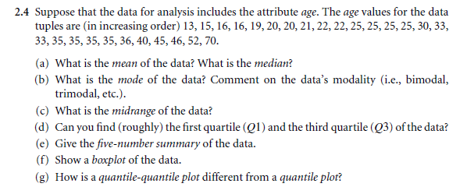

Slide 69
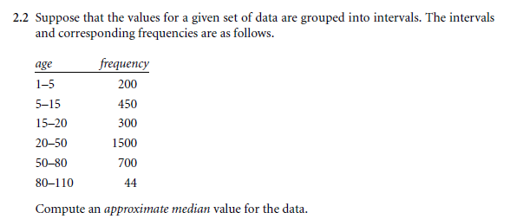

Slide 70
THANK YOU

